Slide 1
P1: Requirements Analysis
Team name: Function;Chaos
Team members: Zach Goodenow, Paul Trapp, Shun Lin, Alber Moied, Martin Hu

Slide 2
Use Cases
Register
Log in
Log out
Create new game
Invite player
Accept/Reject invitation
Quit game
Unregister account
View profile
Start game

Slide 3
Register and Unregister
Register
User should register an account to play the game
User should have an unique ID and password
Unregister
After unregister, all the data including game log of the user must be delete.
Or, back up the information to the database if users want to recover their account.

Slide 4
Login and Logout
Login
When user login, the system should check the information of the user (ex: if the account number and the password is right or not.)
After logined, the user should be show online for the status.
Logout
When user logout, show the user is offline, then all of game function is not available to the user.
Check the game log should be confirmed to store to the game log.

Slide 5
Invite, Accept/Reject the invitation
When the game has been created. User can chose the function of these two.
Invite
Before invite a player, creator should have already created the game and the game should be initialed.
Accept/Reject the invitation
Other player can accept or reject the invitation, and the answer should be reply to the game creator.

Slide 6
Create new game and Start Game
Create new game
Before create the game the user should have log in to the system.
When the game is created, the board should be initial in the beginning
After the game is created, the creator can invite players -- to invite use case
Start Game
Before the game start, system should check if there are enough player for the game.
When the game is started, user cannot invite more players, and the game should be moared as Playing.

Slide 7
Quit game and View Profile
Quit Game
Players can quit the game whenever they want.
When one player request to quit the game, should inform the other player to accept it.
If the game is not finished, player who request to quit the game lose the game.
After quit the game, the log will be stored to game log.
View Profile
The function is for checking the information of each player. (win and lose data)
More, the user can check each games move log which he/she played before. (not necessary)

Slide 8
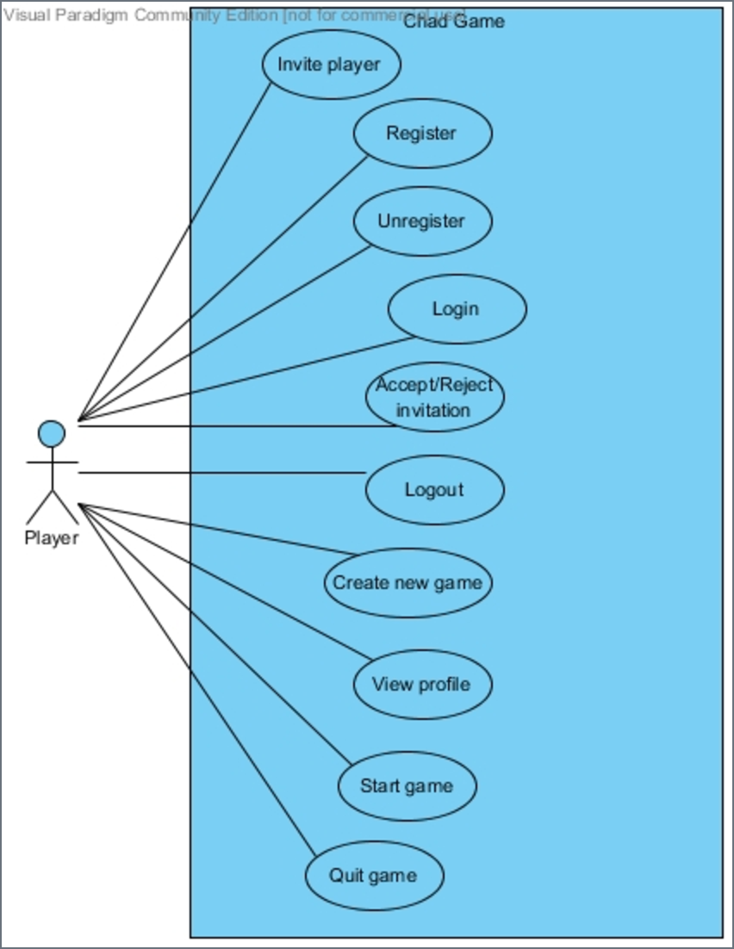
Use Case Diagram
Partial Use case diagram
The only actor is Player ( can be creator
Or guest)
Chad game system support the reactions

Slide 9
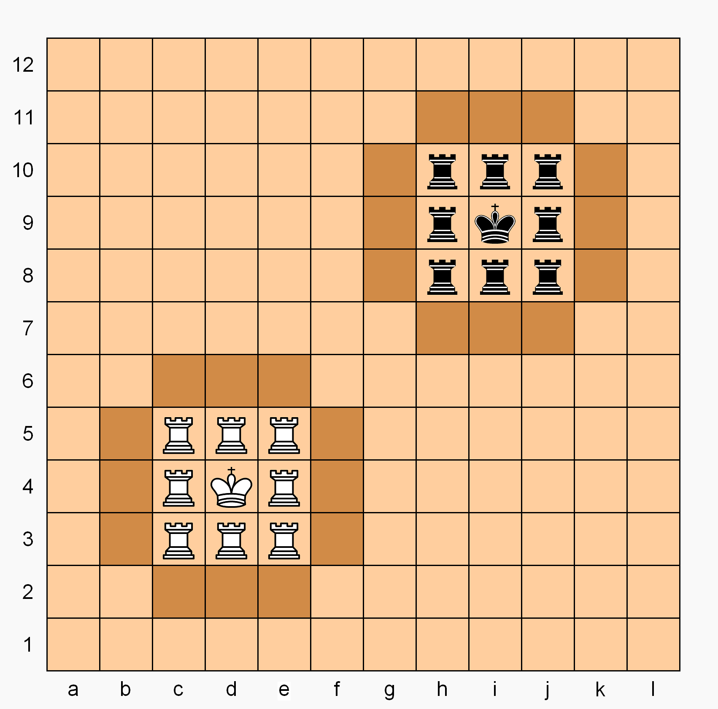
Our Game: Chad
Chess variant
King can move normally or like a knight
King can’t leave its castle
Rook promoted to queen if enters enemy Castle
Game ends when a King is in checkmate

Slide 10
Product Decisions
Opponent could be a real person or the system acting as an AI
GUI would be helpful for playing the game.
Mobile access would be ideal.

Slide 11
Questions?

